Slide 1
The Paper Review Presentation
Arlen, Jianxian Zhang
4336238473
-Determinants of Supply of Non-oil Exports in Brunei Darussalam (K.Anaman and T.Mahmod)

Slide 2

Introduction & Structure
Introduction of Brunei
Part1
(Original Intention of This Paper)
Part2 (Econometric Model and Result)
Part3
(Practical Significance)

Slide 3
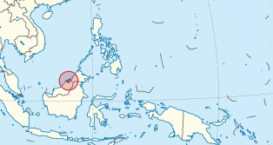


Brunei
Very Tiny Country in Southeastern Asia
Islamic and Democratic Monarchy
Abundant Oil and Gas Deposits

Slide 4
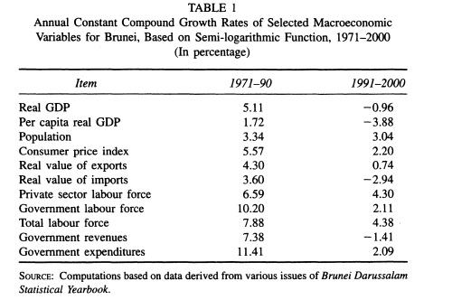
Part1
(Original Intention of This Paper)
Highly depends on oil Industry
Oil crisis makes the disaster to the country’s economy
Extend to other mid-eastern small country
Diversify

Slide 5

Part2 (Econometric Model and Result)
ANOEXP=annual non-oil exports
Price= weighted price index of non-oil exports
Wage=annual wage rate
Costnwi=annual price level of cost other than wage
EER=exchange rate
Goexp=lagged value if the ration of oil export to GDP
Policy=Dummy of government promotional policy

Slide 6

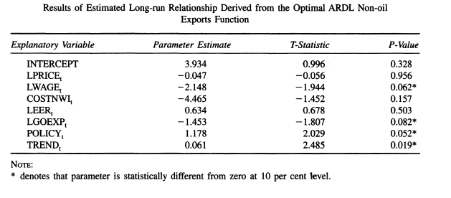
Part2 (Econometric Model and Result)
ARDL-- Pesaran, Shin, Smith (2001)
Result
Stationary
Maximum of one long-run cointegraion relationship

Slide 7
Part3 (Practical Significance)
Labor intensive
Transportation (Products, Labor)

Slide 8
Part3 (Practical Significance)
Dutch Desease
G-Impact
(tax incentives, Foreign labors)

Slide 9
THE END

Slide 10
THANK YOU!

